Slide 1

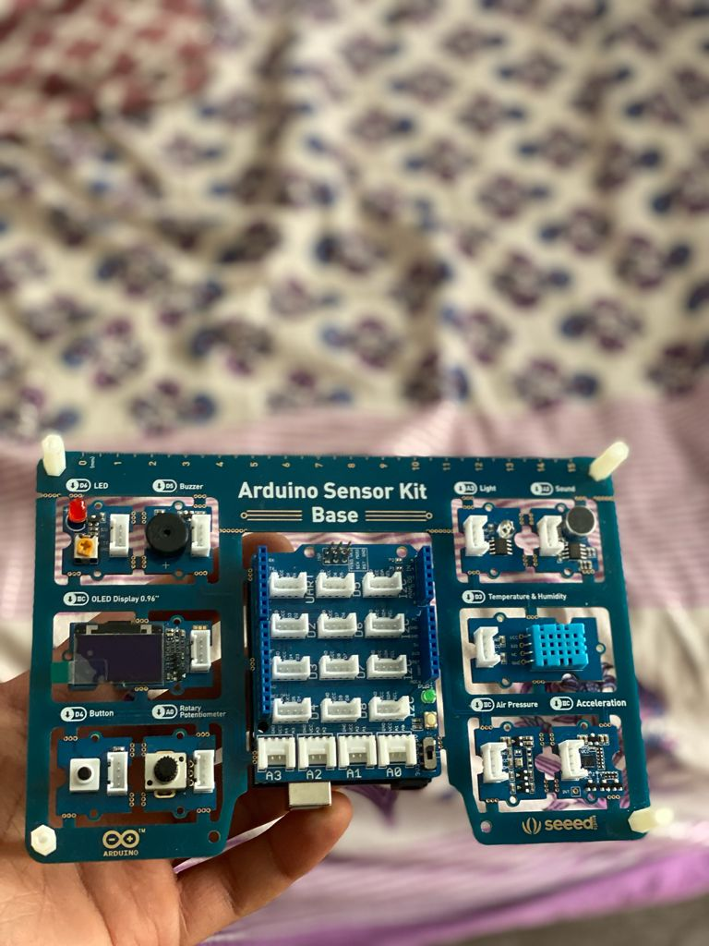
SIT314: Software Architecture and Scalability for Internet-of-Things
Name: Ishan Vij
Student Id: 219056862

Slide 2
Problem Description:
Basically, the aim of this project is to develop a Smart Lighting System which could be maintained for large buildings with many thousands of buildings and switches. The report concentrates on developing a system that implements the smart light system for large building without affecting any other attributes of the building and maintain the scalability to control the intensity of lights and also provide alerts for faulted lights in the building.

Slide 3
Requirements of the System:
The smart lighting system should be scalable for large building which uses thousands of lights and switches which means the reliability and performance of the system should not be affected with increase in lights and switches.
The system should change the intensity of light or turn off and on with respect to the lighting conditions of the environment.
The system should create alert when some of the LEDs stop working or show unusual behaviour. For example, the system can use MQTT with Complex Event Processing to report faulted LEDs and create alert so that those lights could be repaired or replaced.
The data stored for all the room and their LEDs and switches must be stored securely in online databases which could be only accessed by authorised people of the company and should provide good secure protocols to avoid hacking of the data.

Slide 4
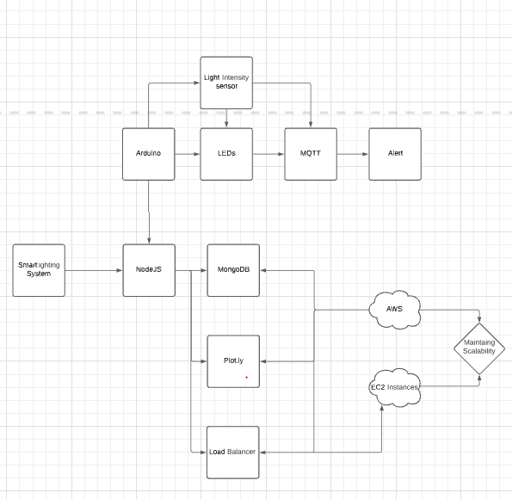
System Design

Slide 5
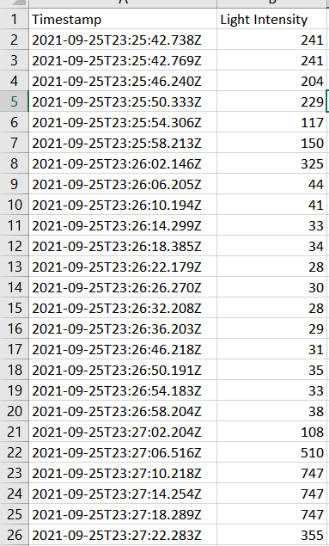
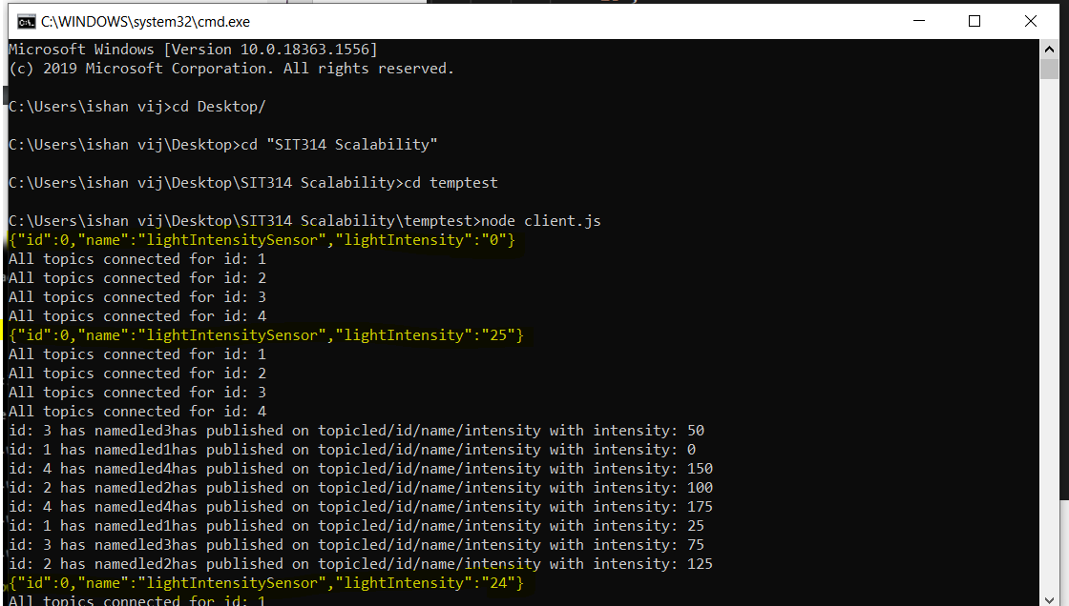
Data Formats
For this task the data is collected in the csv format while collecting from Arduino in an excel file and the same is being used to visualise the data in real time using Plot.ly can be also converted to a JSON format. The advantage of csv file is that it systematically arranges the values from sensors under appropriate columns with time stamps and CSV file is usually smaller in size in comparison to JSON file. Moreover, excel file can make it easy for the user to visualize the data and also allow APIs to post the data easily. Aldo the JSON format is used to upload data to mongo DB.

Slide 6
Demonstration
Link: https://youtu.be/HnCtPuAE4a8

Slide 7

Thank You

